Slide 1



1.D Distributions
Define and explain Linux distributions, and Red Hat
Enterprise Linux

Slide 2

Linux Distributions
Consists of
1
Linux Kernel
2
Supporting user programs and libraries

Slide 3
Linux Distributions
common characteristics:
1
Linux Kernel and user space programs
2
Either single purpose or includes 1000s of programs
3
must provide a means of installing and updating the distribution and its components.
Maintainers provide support for distro and open-source community
4

Slide 4








Distributions & Flavors
Distrowatch.com

Slide 5
Distributions
Development of Red Hat Enterprise Linux
Participate
Integrate
Stabilize

Slide 6







Upstream & Stream
This Photo by Unknown Author is licensed under CC BY-NC
This Photo by Unknown Author is licensed under CC BY-NC

Slide 7
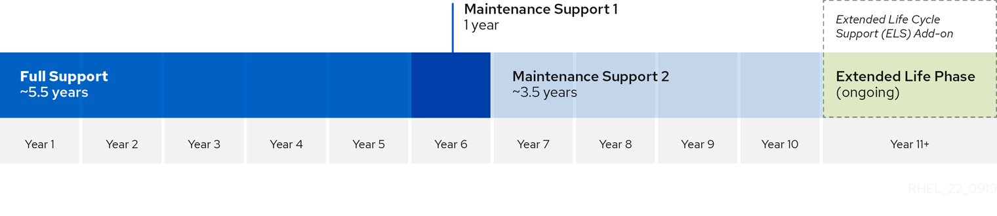
RHEL Lifecycle

